Slide 1
Assessment Of Mean Teacher And Prominent Adversarial Unlabeled Data For Language Classification
Master Thesis Presentation
On
Institute for Business and Management Informatics
University of Koblenz-Landau
Koblenz, March 2022
First Supervisor: Prof. Dr. Andreas Mauthe
Second Supervisor: Mr. Alexander Rosenbaum
Presented By:
Bhupender Kumar Saini
Notes:
Good afternoon,
Today, I am presenting my master thesis topic on

Slide 2
Agenda
Motivation
Research Question
Proposed Methodology
Experiment Details
Data Augmentation
Dataset details
Hyperparameters
Experiment Result Analysis
Discussing Research Question
Conclusion, Limitation, and Future Works
References
Questions
Notes:
Agenda of todays presentation is
I will be giving brief motivtation behind the master thesis,
and research question.
Later, proposed methodology, experiment details and result will be presented .
Afterwards, I will give a brief explanation about research question
And will conclude this presenation with limitation and future works,

Slide 3
MOtivation
Master thesis topic
Comparatively less studied topic in NLP [2]
Language models are prone to adversarial attacks [3]
Lack of labelled data demands semi-supervised approach
Evaluating performance of mean teacher fine tunning of Language model.
Introducing noise strategies
Scope of improvement in conventional fine-tuning
Mean teacher approach [5]
Demands focussed approach on adversarial training.
References
Christian Szegedy et al. “Intriguing Properties of Neural Networks”. (Feb. 2014).
Wenqi Wang et al. “Towards a Robust Deep Neural Network in Texts: A Survey”.
Di Jin et al. “Is BERT Really Robust? A Strong Baseline for Natural Language Attack on Text Classification and Entailment” , (Apr. 2020).
Nicolas Papernot et al. “Crafting Adversarial Input Sequences for Recurrent Neural Networks”. In: arXiv:1604.08275 [cs] (Apr. 2016). arXiv: 1604.08275 [cs].
Antti Tarvainen and Harri Valpola. “Mean Teachers Are Better Role Models: Weight- averaged Consistency Targets Improve Semi-Supervised Deep Learning Results”.
Notes:
After introduction of BERT model in 2019, Despite state-of-art performance, in 2020, Jin work showed that BERT model is not robust. Their performance degrades drastically. The accuracy of BERT model dropped below 10 %
, >
Which raises question, can model performance be increased by improving conventional fine-tuning approach when robustness is concerned.
>
According to wang survey, Adversarial attacks are more studied topic in computer visualization domain [2] than NLP.
And, studies published in NLP showcased different strategies to craft adversarial sample and different varients of BERT model came into picture to improve model generalization but, unfortunately study direction was least concentrated on robustness enhancement and evaluation.
>
On the other hand,
Various NLP tasks such as fake news detection suffers from lack of labelled data which demands semi-supervised approach.
In CV, Mean teacher approach presented by Tarvarian, claimed to provide robust and accurate model but , the robustness evaluation was still a open scope.
>
And implementing such approach in text domain require diffferent noise strategies. Which can be created using language model capabilities such as back translation and context rewriting.
>
And, Implementing mean teacher approach in fine-tuning language model and evaluating against adversarial attack was the motivation behind this master thesis.

Slide 4
Research Question
Is the proposed mean teacher semi-supervised fine-tuning and the use of prominent adversarial unlabelled data an effective method to improve the robustness of language models, specifically concerning accuracy under attack without compromising the original accuracy in contrast to the conventional fine-tuning approach?
Implementing Mean Teacher approach in text domain
Utilizing attack recipes
Robustness evaluation
Creating prominent adversarial unlabeled data.
Introducing crafted adversarial unlabelled data into training.
BERT [1] and DistillBERT [2] model
Fine-tuned using conventional approach.
MTBERT and MTDistillBERT model
Fine-tuned using proposed mean teacher approach.
Notes:
Two main question lead to this research question
Is mean teacher semi-supervised approach effects the robustness of language model?
Can prominent unlabelled data created by langauge models enhance the model performance ?
The hypothesis was the language model fine-tuned using proposed approach will be comparatively more robust to conventional fine-tuning approach.
I have broken the master thesis into 5 work packages.

Slide 5
Proposed methodology

Slide 6
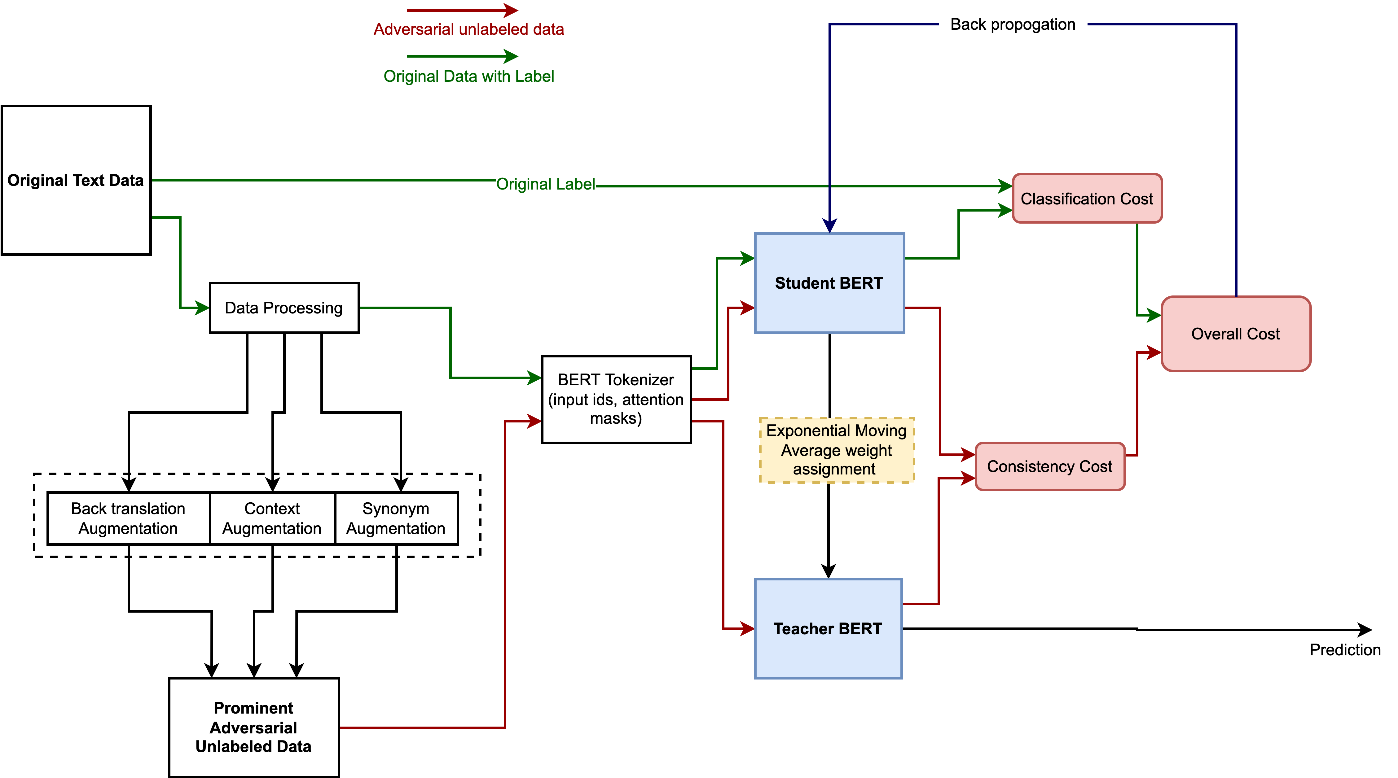
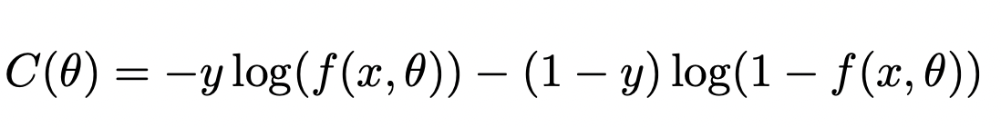
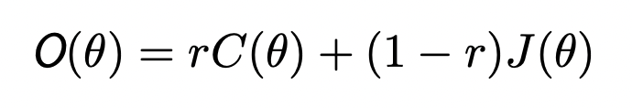
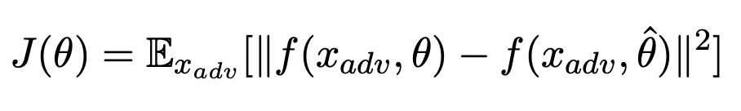
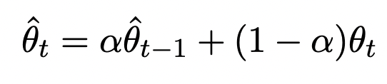

Slide 7
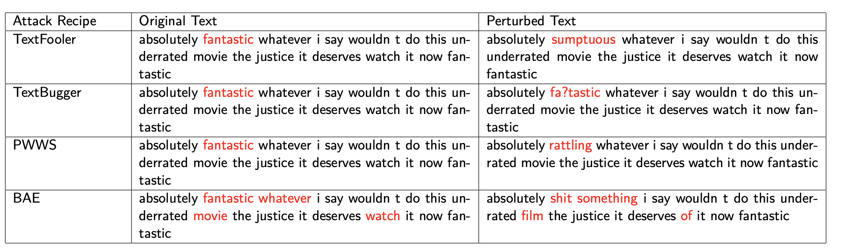
Attack Recipes Used for Evaluation
TextFoolerJin2019 [1].
TextBugger [2].
PWWSRen 2019 [3].
BAEGarg2019 [4].
Common Strategy
Identifying important words.
Replacement strategies.
Perturbation examples of attack recipes in this experiment.
References
Di Jin et al. “Is BERT Really Robust? A Strong Baseline for Natural Language Attack on Text Classification and Entailment”.
Jinfeng Li et al. “TextBugger: Generating Adversarial Text Against Real-world Applications”.
Shuhuai Ren et al. “Generating Natural Language Adversarial Examples through Probability Weighted Word Saliency”.
Siddhant Garg and Goutham Ramakrishnan. “BAE: BERT-based Adversarial Examples for Text Classification”.
John X. Morris et al. “TextAttack: A Framework for Adversarial Attacks, Data Augmentation, and Adversarial Training in NLP”.
Notes:
four black box attack recipes that satisfy lexical, grammatical, and semantic constraints was reason behind selecting these attack recipes.
These examples are created in this experiment.
Textfooler and BAE find important word by change in probability before and after deleting words.
Textbugger and PWWS by converting token to unknown
Replacement
Textfooler→ replacing word which has high similarity score between sentences.
TextBugger enters bugs at character and word level which can be seen in example.
PWWS uses WordNet for replacement
BAE uses BERT model to predict masked word.

Slide 8
Experiment details

Slide 9
Dataset
Dataset | Total | Attack dataset | Avg. Length | Aug. unlabled dataset
Codalab¹ ^{Covid-19 Fake tweets} ^{(Fake/Real)} | 6090 (3199/2891) | 2000 (1071/969) | 25 | 6090
IMDB² ^{Sentiment} ^{(Positive/Negative)} | 6050 (3025/3025) | 2000 (1000/1000) | 127 | 6050
Data Preprocessing
HTML tags removal.
Digit removal.
Lower casing.
Punctuation removal.
Dataset details for the experiment.
IMDB dataset has comparatively higher number of correct words, and larger text length too.
Fake tweet dataset is collection of tweets so have incorrect spellings (hashtags), lower vocabulary size, and text length.
Reference
Parth Patwa et al. “Fighting an Infodemic: COVID-19 Fake News Dataset”. In: arXiv:2011.03327 [cs] (Mar. 2021). arXiv: 2011.03327 [cs]
Andrew L. Maas et al. “Learning Word Vectors for Sentiment Analysis”. In: Proceedings of he 49th Annual Meeting of the Association for Computational Linguistics: Human Language Technologies.
https://texthero.org/

Slide 10
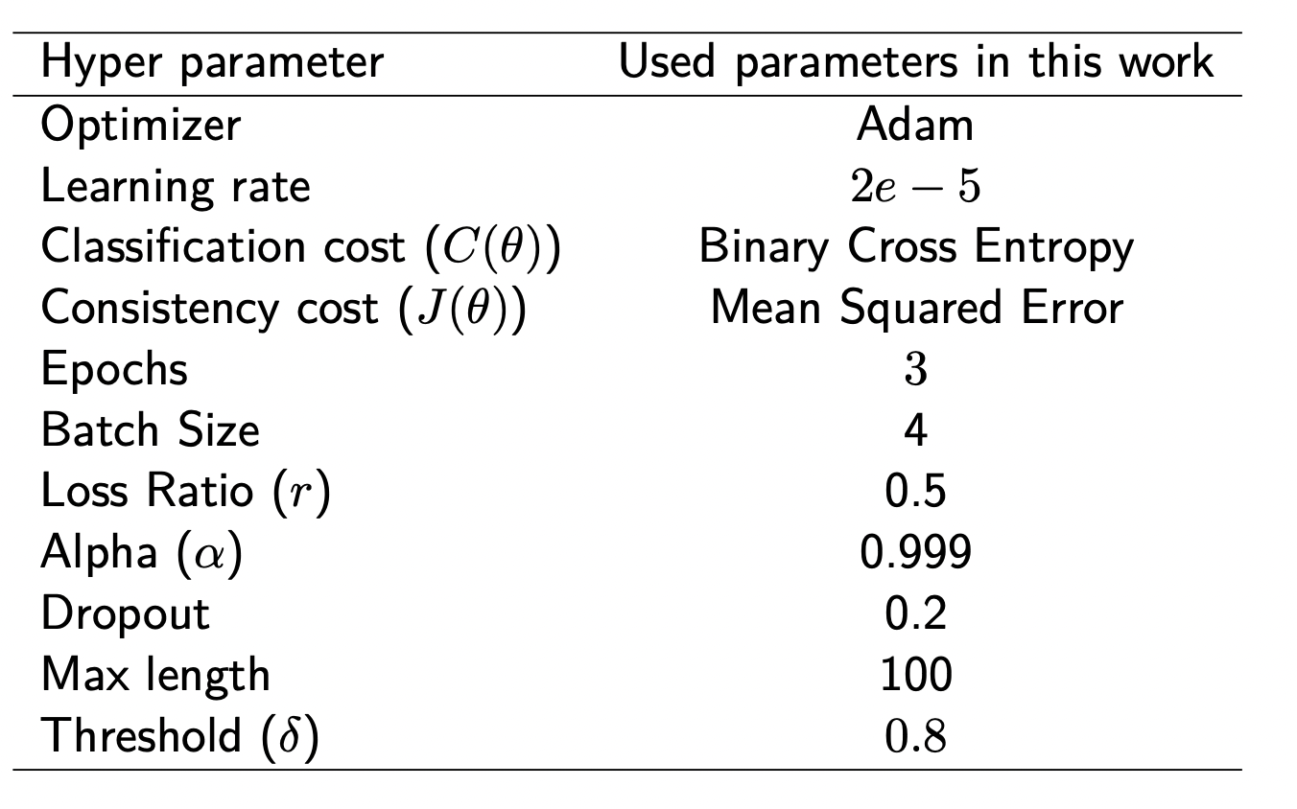
Hyperparameter
Hyperparamter details

Slide 11
Evaluation Metrics
Original Accuracy(%): Total correct predictions given the number of test samples.
Accuracy Under Attack(%): Accuracy shown by model under attack. (More is good, less is bad : For model)
Attack Success Rate(%): Accuracy of attack recipes in attacking the models. (No. of successful attack/ attack attempts)
Average Perturbation(%): Average number of words needs to change in the test samples. (Lower is better, Higher is bad : For model)
Average Number of queries: Average number of queries while attacking the model.(Higher is better, and lower is bad : For model).
Perturbation Score: Prediction Probability of successful attack. (Lower confidence score in case of successful attack is good for model)
Notes:
Hypothesis:
MT BERT and MT DistilBERT should have:
Higher Original Accuracy than baseline model.
Higher Accuracy under Attack than baseline models.
Lower Success Rate than baseline model.
Higher Perturbation rate than baseline models.
Higher Average Number of queries required to get attacked than baseline models.
Lower range of perturbation score of successful attacks.
Perturbation score signals about resilient towards attacks if the model is not allowing attack recipes to predict wrong label with high confidence.

Slide 12
Data Augmentation
Synonym based
WordNet lexical English database [1] is used as a source of synonym augmentation.
For IMDB and Covid-19 fake tweets datasets, it is augment threshold set to 50 and 15, respectively.
Context based
DistilBERT language model is utilized.
Back translation
Helsinki-NLP language model from Huggingface² is used.
References
George A. Miller. “WordNet: A Lexical Database for English”. In: Communications of the ACM 38.11 (Nov. 1995), pp. 39–41. issn: 0001-0782. doi: 10.1145/219717.219748.
https://huggingface.co/Helsinki-NLP

Slide 13
Experiment Result analysis

Slide 14
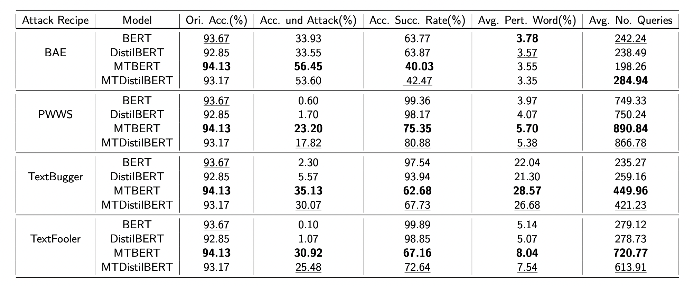
Experiment results - IMDB Dataset
Overall, MT BERT has shown better original accuracy and Accuracy under attack.
Except Average perturbation in BAE attack recipe, MTBERT has outperformed all mentioned model.
IMDB dataset: MTBERT performed best in the experiment, followed by MTDistilBERT. Bold and underlined values represent first and second best values.
Notes:
Results shows that language model fine-tuned using conventional approach degrades drastically.
For most to the attack recipes except BAE, it is showing lower than 6 percent.
Followed by MTDistilBERT

Slide 15
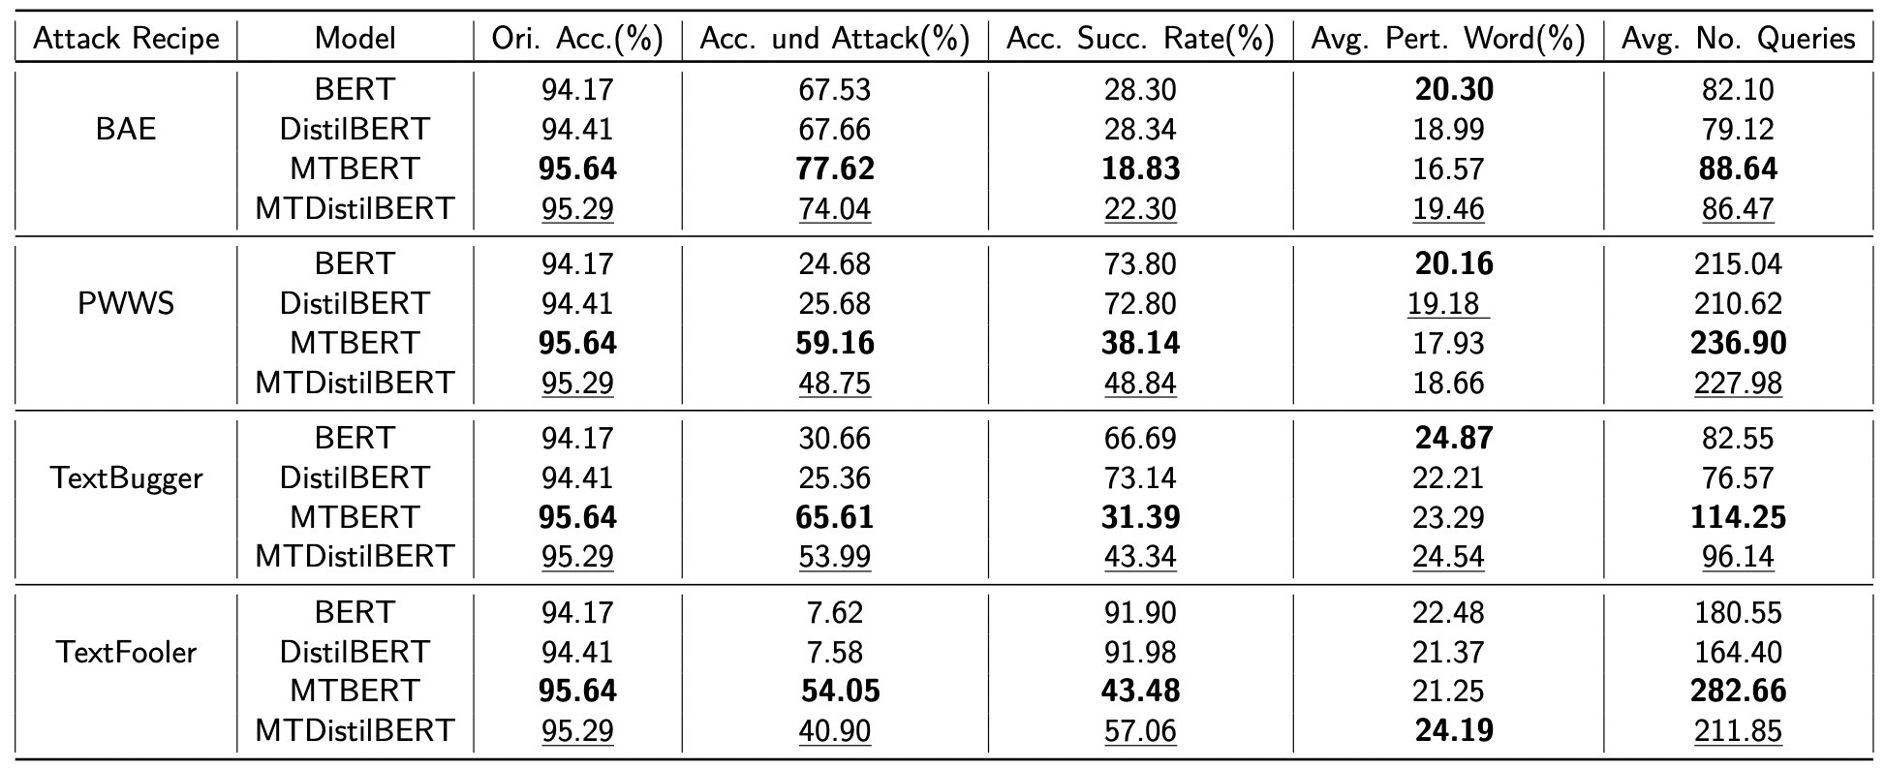
Experiment results- Covid-19 fake tweets dataset
Except Average perturbation in BAE attack recipe, MTBERT has outperformed all mentioned model.
Covid-19 fake tweets dataset: MTBERT model has performed well overall, followed by MTDistilBERT. Bold and underlined values represent first and second best values.
Notes:
Followed by MTDistilBERT

Slide 16
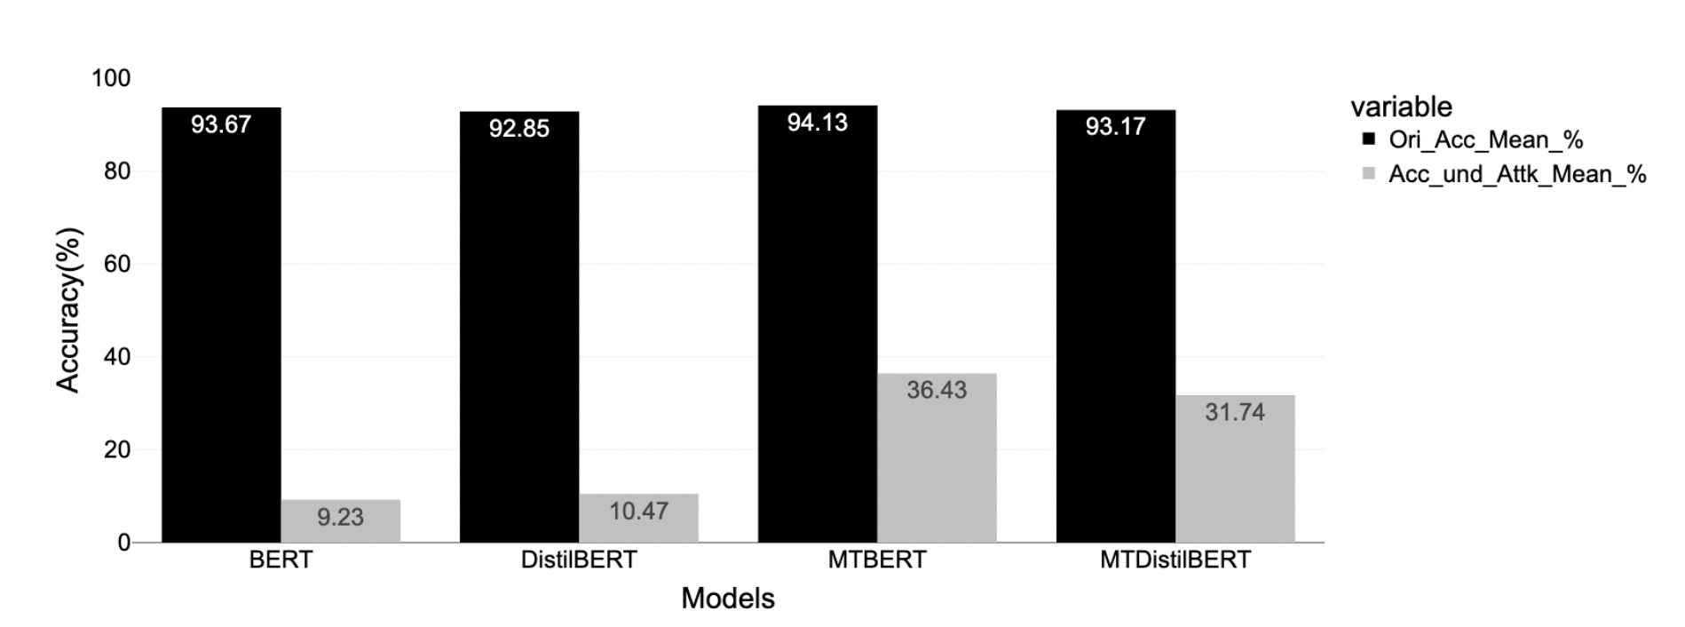
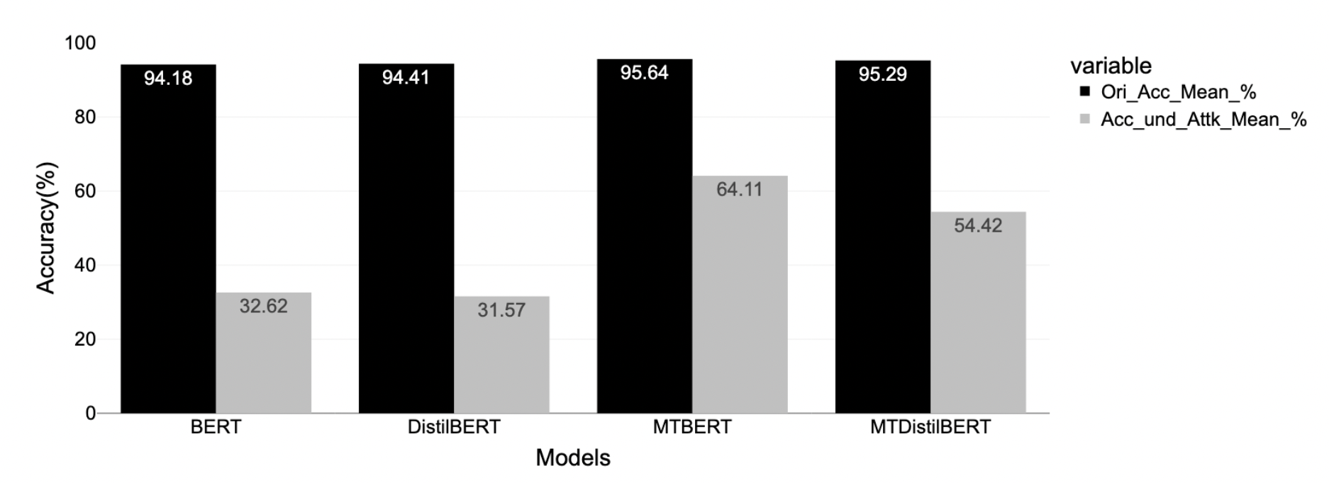
Accuracy
Model fine-tuned using proposed approach (MTBERT and MTDistilBERT) shown better original accuracy and accuracy under attack.
MTBERT has shown better original accuracy (0~2% better).
MTBERT has shown 20∼30% improvement in accuracy under attack.
IMDB Dataset: Mean Original Accuracy and Accuracy under attack considering four attack recipes.
Covid-19 fake tweet: Mean Original Accuracy and Accuracy under attack considering four attack recipes.

Slide 17
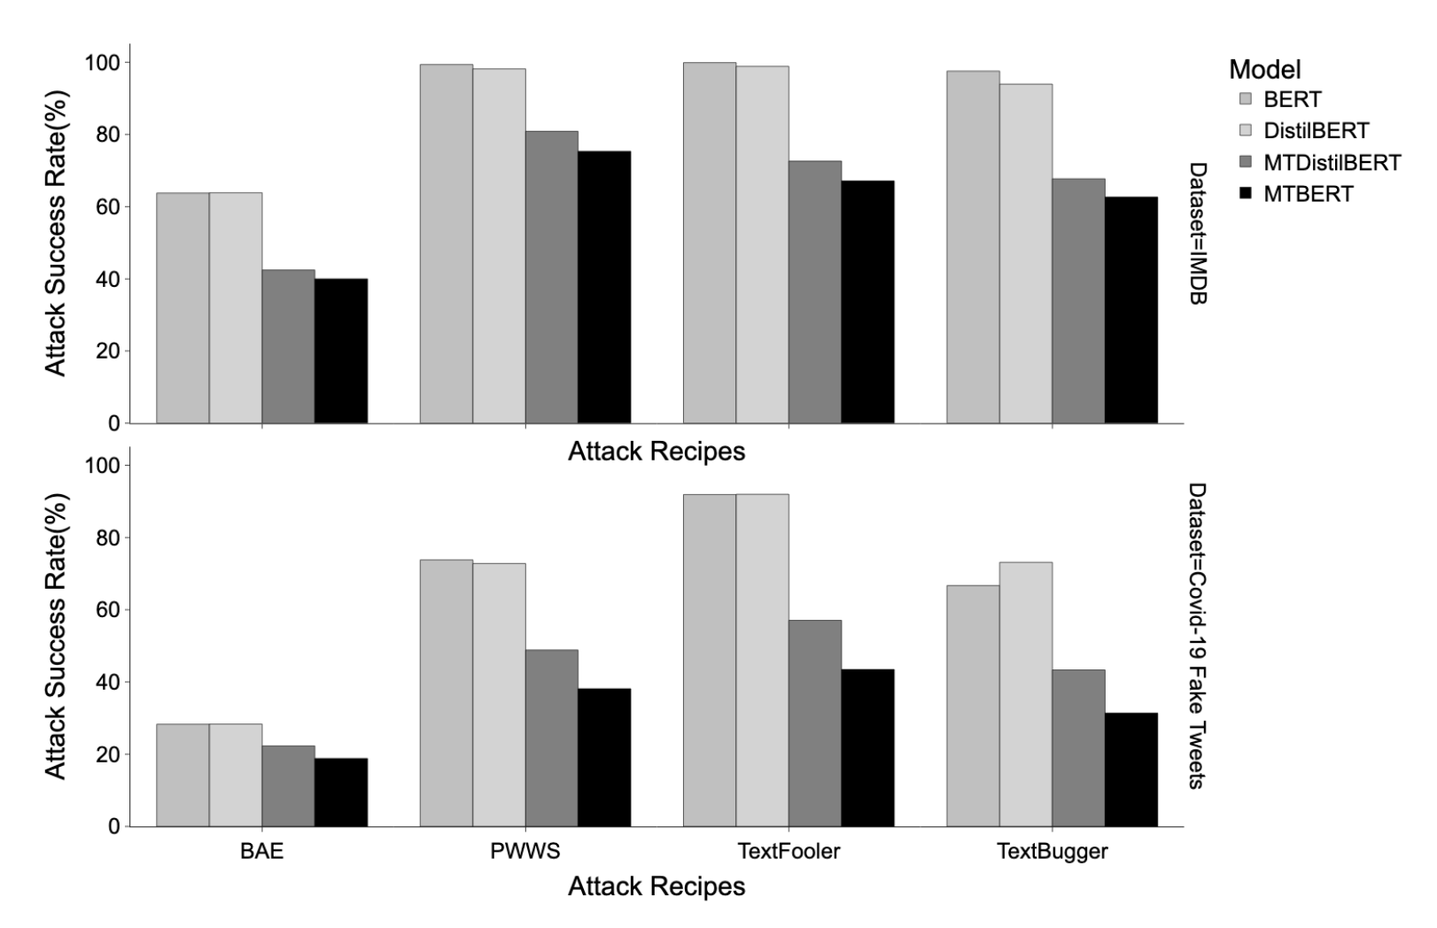
Attack success rate
The TextFooler attack recipe observed to be most effective at attacking the language models followed by PWWS.
On the other hand, BAE has been least effective, followed by TextBugger.
language models fine-tuned using the proposed approach show the lowest attack success rate.
Bar plot of attack success rate

Slide 18
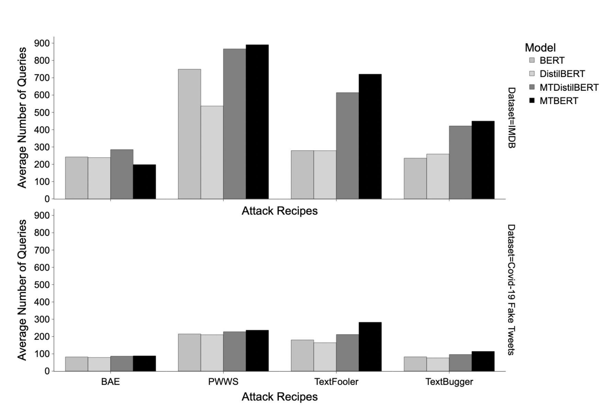
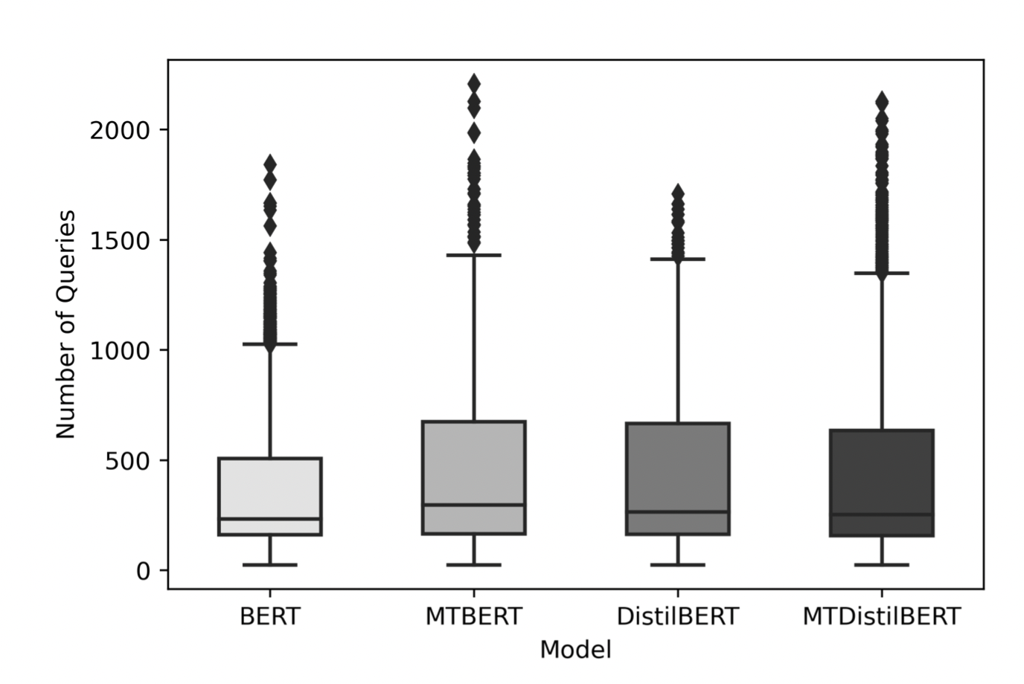
Number of Queries
Box plot of the number of queries.
Bar plot of the number of queries.
The proposed approach models are comparatively broader and showed greater values for outliers than baseline models.
MTBERT model require higher queries for attacking except BAE attack Recipes.
PWWS require high queries to attack followed by TextFooler.
Notes:
MTBERT model showed comparatively higher queries requirement followed by MTDistilBERT
>
In terms of attack recipes,
TextFooler and PWWS has shown significant difference in both dataset.
TextFooler: the difference in between MT BERT and BERT is significantly higher or doubled in case of IMDB dataset.
That may be because of relation with text length and vocabulary as mentioned in TextFooler and PWWS paper.

Slide 19
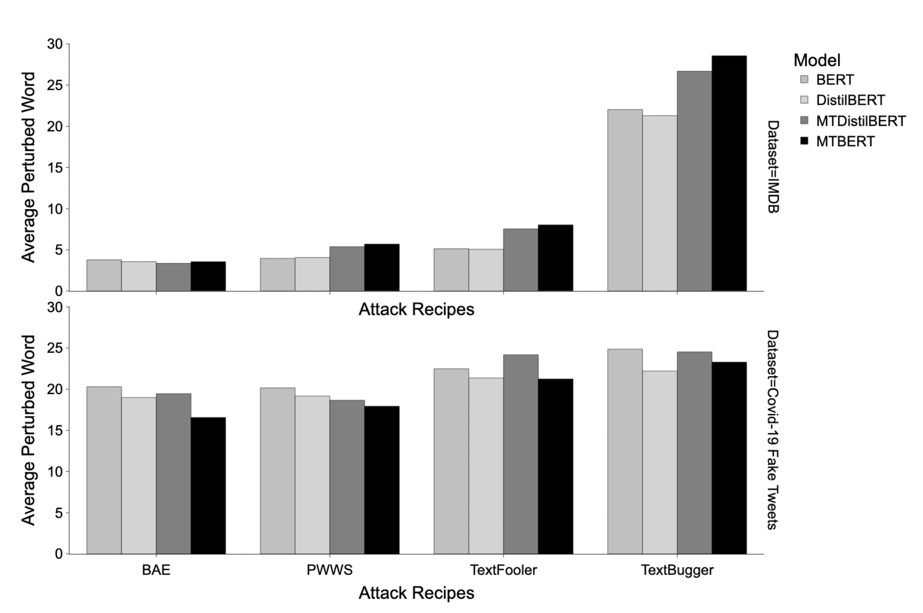
Word perturbation
In IMDB dataset, MTBERT model has shown highest perturbation requirement followed by MT DistilBERT.
In case of Fake tweets Dataset, BERT model has shown highest.
The difference of perturbation in between dataset is higher.
Bar plot of word perturbation as per datasets and attack recipes.
Notes:
In IMDB dataset, Model fine tuned by the propsed approach has shown higher word perturbation requirement.
>
But, surprisingly. in case of fake tweet dataset BERT has higher perturbation rate followed by MTdistilBERT.
>
In terms of attack recipes, except textbugger, all other attack recipes showed higher perturbation in lower length dataset that is fake tweet dataset but lower perturbation in IMDB dataset.
Which shows there dependencies with vocablury size and length.
Longer text data require lesser word perturbation.

Slide 20
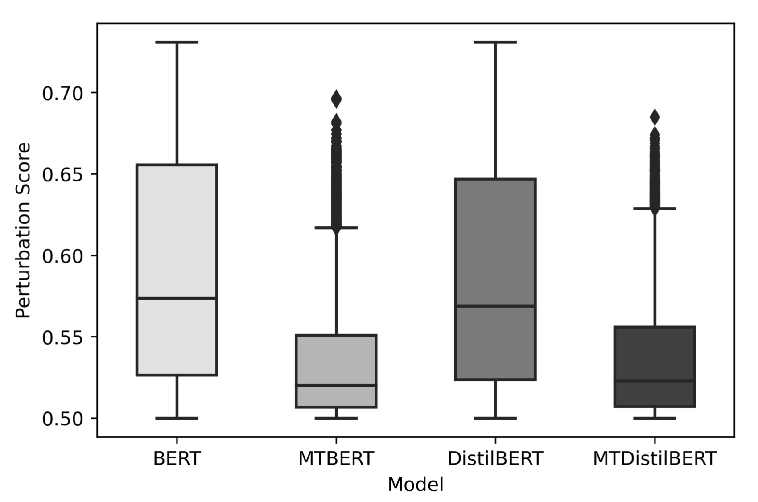
Perturbation score
MTBERT model has managed attacks confidence score in the leaner interquartile range.
And, does not allow to cross 0.70.
Model fine-tuned using proposed approach is comparatively significant leaner than model fine-tuned using conventional approach.
Box plot of perturbation score considering both dataset

Slide 21
Discussing Research question
Experiment result supports hypothesis
Data Augmentation
- Including noisy data increase robustness if suitable loss is introduced in the training called consistency regularization [1,2].
- Proposed approach exploit consistency regularization.
Exponential Moving Average
- Ensemble technique can lead to a stronger predictor.
- Laine [4] implemented ensemble technique during training.
- Averaging weights over time also provides a more accurate model than using final weights directly [3].
- Teacher model is an average of consecutive student models.
References
Erik Englesson and Hossein Azizpour. “Consistency Regularization Can Improve Robustness to Label Noise”. In: arXiv:2110.01242 [cs, stat] arXiv: 2110.01242 [cs, stat].
Yonatan Belinkov and Yonatan Bisk. “Synthetic and Natural Noise Both Break Neural Machine Translation”. In: arXiv:1711.02173 [cs] (Feb. 2018). arXiv: 1711.02173 [cs].
B. T. Polyak and A. B. Juditsky. “Acceleration of Stochastic Approximation by Averag ing”. In: SIAM Journal on Control and Optimization 30.4 (July 1992), pp. 838–855. issn: 0363-0129. doi: 10.1137/0330046.
Samuli Laine and Timo Aila. “Temporal Ensembling for Semi-Supervised Learning”. In: arXiv:1610.02242 [cs] (Mar. 2017). arXiv: 1610.02242 [cs].
Notes:
Language models fine-tuned with the proposed approach has shown a improvement over conventional method of fine-tuning in terms of robustness without compromising original accuracy.
>
During investigation about the observed behaviour, two major strategies were found to be most prominent explanation.
>
instead of taking an average of many models decision, teacher model is a mean of consecutive students models weights hence called mean teacher.

Slide 22
Conclusion
Language model are sensitive to adversarial attacks.
Improves generalization and robustness
More resilient towards attacks
Examined language model capabilities
Consistency Regularization and Exponential Moving Average
Opportunity to gain understanding
Notes:
Language models are sensitive to adversarial attacks.
It was observed in the experiment that proposed approach of fine-tuning improved original accuracy by 0∼2% and accuracy under attack by 20∼30%.
The model fine tuned using proposed approach is more resilient to attacks and does not allow attack recipes to sabotage models with high confidence.
This master thesis also examined the eﬀicacy of data augmentation techniques that utilizes the capabilities of language models.
Research studies was conducted to investigate the cause of the observed behaviour. Consistency regularization and Exponential Moving Average (EMA) weight assignments were found to be the most prevalent explanations for the observed behaviour.
The opportunity to advance the understanding of language models, data augmentation, and various adversarial attacks in the text-domain.

Slide 23
Limitations
Hard to achieve Image level Imperceptibility
Space and Time complexity
No common assessment criteria
No single defence to prevent from all
Implementation challenge
Notes:
Image level imperceptibility is still a challenge in text domain. Human can detect character level change in the sentence.
Comparatively more space and time-consuming than the conventional approach.
No common assessment criteria or frameworks for evaluating the robustness was available.
Apart from showing improvement in robustness, but this mechanism doesn’t prove to be resilient to all kind of attacks.
Attacks, data augmentation techniques, and semi-supervised training methodologies present in the image domain cannot be applied directly to the text domain.

Slide 24
Future Work
Extreme pre-training hurts robustness
Quantitative analysis of individual augmentation techniques
Reducing computational complexity
Comparing performance of Virtual adversarial and Mean teacher approach
Interpretability
Building Verification framework
Notes:
Hypothesis: Extreme pre-training of language models can hurt model robustness.
Quantitatively measuring the effectiveness of individual augmentation techniques on robustness can be studied.
Working towards reducing computational complexity.
Comparing the performance of gradient-based adversarial training and the proposed fine-tuning approach.
Building a common robustness verification framework that can be used to compare various methodologies.
Explaining the model predictions using adversarial attacks.

Slide 25
Refernces
Christian Szegedy et al. “Intriguing Properties of Neural Networks”. (Feb. 2014).
Wenqi Wang et al. “Towards a Robust Deep Neural Network in Texts: A Survey”. In: arXiv:1902.07285 [cs] (Apr. 2021). arXiv: 1902.07285 [cs]
Di Jin et al. “Is BERT Really Robust? A Strong Baseline for Natural Language Attack on Text Classification and Entailment”. In: Proceedings of the AAAI Conference on Artificial Intelligence 34.05 (Apr. 2020), pp. 8018–8025. issn: 2374-3468. doi: 10.1609/aaai. v34i05.6311.
Nicolas Papernot et al. “Crafting Adversarial Input Sequences for Recurrent Neural Net- works”. In: arXiv:1604.08275 [cs] (Apr. 2016). arXiv: 1604.08275 [cs].
Antti Tarvainen and Harri Valpola. “Mean Teachers Are Better Role Models: Weight- averaged Consistency Targets Improve Semi-Supervised Deep Learning Results”. In: arXiv:1703.01780 [cs, stat] (Apr. 2018). arXiv: 1703.01780 [cs, stat].
Jinfeng Li et al. “TextBugger: Generating Adversarial Text Against Real-world Applications”. In: Proceedings 2019 Network and Distributed System Security Symposium (2019). doi: 10.14722/ndss.2019.23138. arXiv: 1812.05271.
Siddhant Garg and Goutham Ramakrishnan. “BAE: BERT-based Adversarial Examples for Text Classification”. In: arXiv:2004.01970 [cs] (Oct. 2020). arXiv: 2004.01970 [cs].
Shuhuai Ren et al. “Generating Natural Language Adversarial Examples through Prob- ability Weighted Word Saliency”. In: Proceedings of the 57th Annual Meeting of the Association for Computational Linguistics. Florence, Italy: Association for Computational Linguistics, July 2019, pp. 1085–1097. doi: 10.18653/v1/P19-1103.
George A. Miller. “WordNet: A Lexical Database for English”. In: Communications of the ACM 38.11 (Nov. 1995), pp. 39–41. issn: 0001-0782. doi: 10.1145/219717.219748.
Jacob Devlin et al. “BERT: Pre-training of Deep Bidirectional Transformers for Language Understanding”. In: arXiv:1810.04805 [cs] (May 2019). arXiv: 1810.04805 [cs].
Victor Sanh et al. “DistilBERT, a Distilled Version of BERT: Smaller, Faster, Cheaper and Lighter”. In: arXiv:1910.01108 [cs] (Feb. 2020). arXiv: 1910.01108 [cs].
John X. Morris et al. “TextAttack: A Framework for Adversarial Attacks, Data Augmentation, and Adversarial Training in NLP”.
Parth Patwa et al. “Fighting an Infodemic: COVID-19 Fake News Dataset”. In: arXiv:2011.03327 [cs] (Mar. 2021). arXiv: 2011.03327 [cs]
Andrew L. Maas et al. “Learning Word Vectors for Sentiment Analysis”. In: Proceedings of he 49th Annual Meeting of the Association for Computational Linguistics: Human Language Technologies. Portland, Oregon, USA: Association for Computational Linguistics, June 2011.
Yonatan Belinkov and Yonatan Bisk. “Synthetic and Natural Noise Both Break Neural Machine Translation”. In: arXiv:1711.02173 [cs] (Feb. 2018). arXiv: 1711.02173 [cs].
Erik Englesson and Hossein Azizpour. “Consistency Regularization Can Improve Robust- ness to Label Noise”. In: arXiv:2110.01242 [cs, stat] (Oct. 2021). arXiv: 2110.01242 [cs, stat].
Samuli Laine and Timo Aila. “Temporal Ensembling for Semi-Supervised Learning”. In: arXiv:1610.02242 [cs] (Mar. 2017). arXiv: 1610.02242 [cs].

Slide 26
Questions

Slide 27
Thank you
Project Github link : https://github.com/bksaini078/Mean-Teacher-BERT-Robustness-Assessment

